Slide 1
初階影像處理、嵌入式機器人視覺 及人機互動 (Introduction to Image Processing, Embedded Robot Vision and Human-Computer Interaction) Homework 1
TA:
Edward: thanhng1985@gmail.com
Charlie: p76074664@mail.ncku.edu.tw
Office Hour: 15:00~17:00, Mon. 20:00~22:00, Tue.
At CSIE 9F Robotics Lab.

Slide 2
Notice (1/2)
No Plagiarism!! If you plagiarize, you will get 0.
If TA can’t compile and run your homework. Within one week, come to our Lab (65904) and present (demo) your homework. (or your score will be zero)
Deadline => 2018/10/15 (Mon.) 23:59:59
No delay. If you submit homework after deadline, you will get 0.
Upload to => 140.116.154.1 -> Upload/Homework/OpenCv_Hw1
Account: opencv2018
Password: opencv2018
Format:
Filename:
Hw1_Student ID_Name_Version.rar, ex: Hw1_F71234567_林小明_v1.rar
If you want to update your file, change ver., ex: Hw1_F71234567_林小明_v2.rar
Content: whole project (including images), (Please delete the debug file)

Slide 3
Notices (2/2)
C++ (check MFC guide in ftp)
OpenCV 3.3.1 (https://opencv.org/release.html)
Visual Studio 2015 (download from http://www.cc.ncku.edu.tw/download/)
UI framework: MFC
Python (check pyqty guide om ftp)
opencv-python (3.4.3.18)
Python 3.6.5 (https://www.python.org/downloads/)
UI framework: pyqt5 (5.11.3)

Slide 4
Assignment scoring (Total: 100%)
0. GUI
1. (20%) Image Processing (出題：Tri, Helen, Ann, Ford, Phu)
1.1 Load Image File (5%)
1.2 Color Conversion (5%)
1.3 Image Flipping (5%)
1.4 Blending (5%)
2. (20%) Edge Detection (出題：Ben, Carol)
3. (20%) The Gaussian and Laplacian Pyramids (出題：Erin, Daniel, Oscar)
4. (20%) Adaptive Threshold (出題：Edward, Jenny)
4.1 Global Threshold (10%)
4.2 Local Threshold (10%)
5. (20%) Image Transformation (出題：Tri, Helen)
5.1 Rotation, scaling, translation (10%)
5.2 Perspective transform (10%)

Slide 5
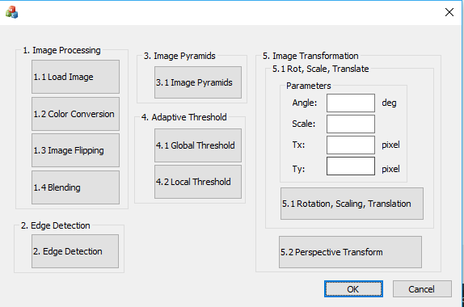
0. GUI
Use MFC to create GUI like following picture.

Slide 6
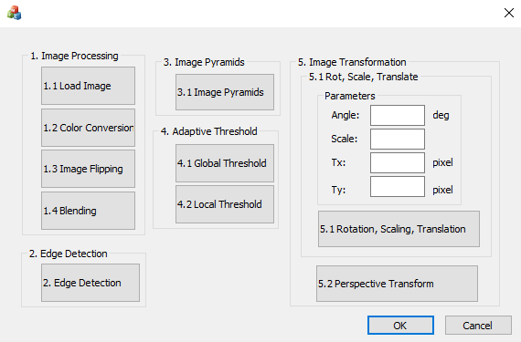
1. (20%) Image Processing (出題： Tri, Helen, Ann, Ford, Phu)
1.1 Load Image File (5%)
1.2 Color Conversion (5%)
1.3 Image Flipping (5%)
1.4 Blending (5%)

Slide 7
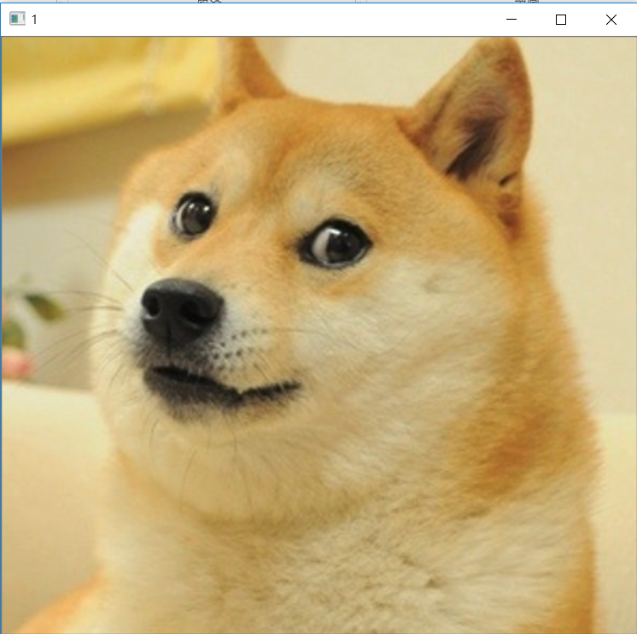
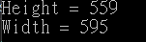
1.1 Load Image File (5%)
Given: dog.bmp image
Q: 1) Open a new window to show the image (dog.bmp)
2) Show the height and width of the image in console mode
Hint : Textbook Chapter 2, p. 22~23

Slide 8
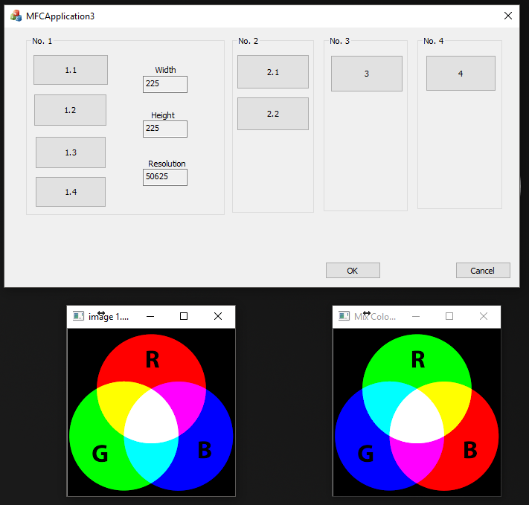
1.2 Color Conversion (5%)
Given: a color image, “color.png”
Q: 1) Exchange 3 channels of the image BGR to RBG 2) Open a new window to show the result.
Example：BGR value of pixel P is P(a,b,c), the value of pixel P will be P(b,c,a) after changing.
Hint: Textbook Chapter 3, p.31 ~ p.44

Slide 9
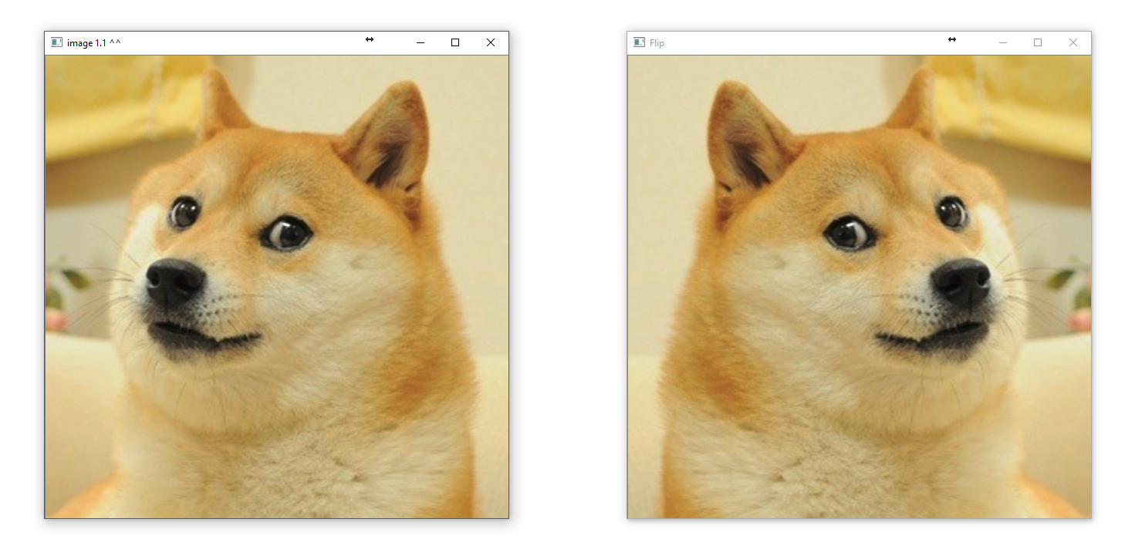
1.3 Image Flipping (5%)
Given: an image, dog.bmp
Q: 1) Flip the image (dog.bmp) and open a new window to show the result.
Hint: Textbook Chapter 3, p.31 ~ p.44

Slide 10
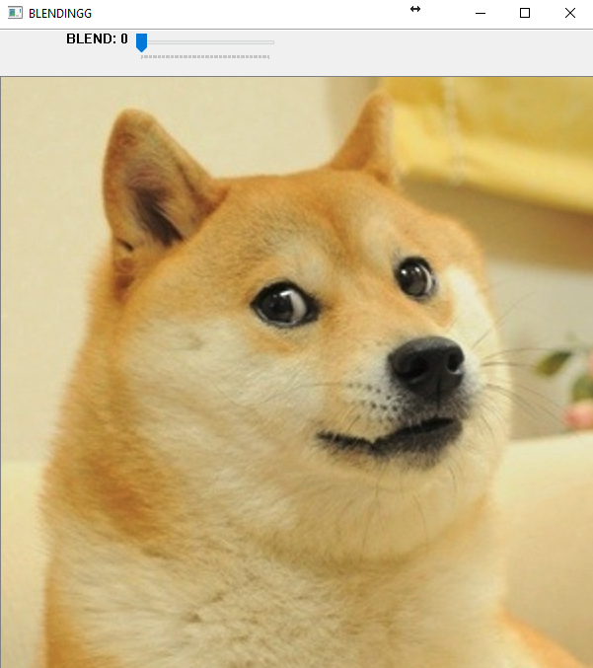

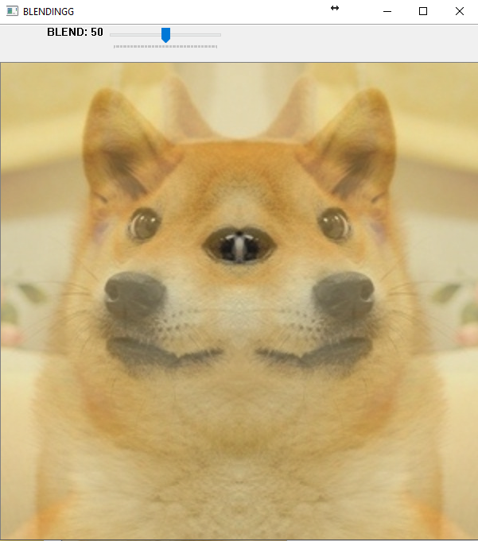
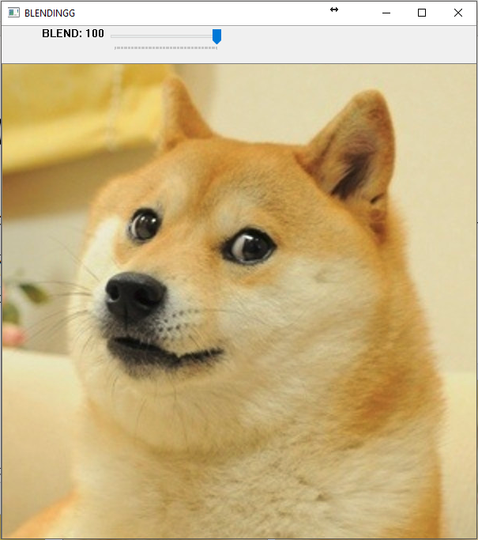
1.4 Blending (5%)
Given: 2 images, dog.bmp and the result of 1.3
Q: 1) Combine two images (dog.bmp and the result of 1.3). 2) Use Trackbar to change the weighting and show the result in the new window.
Hint:
Textbook Chapter 3, p. 51 ~ 51
createTrackbar(...);

Slide 11
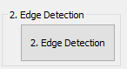
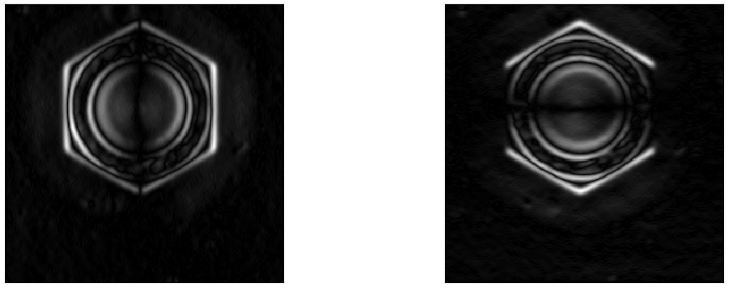
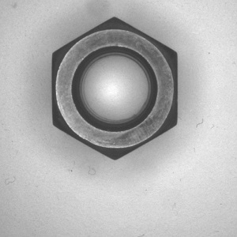

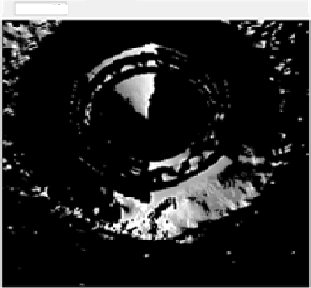
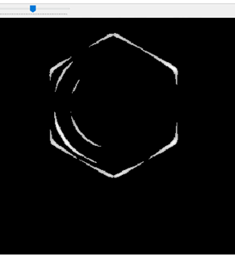
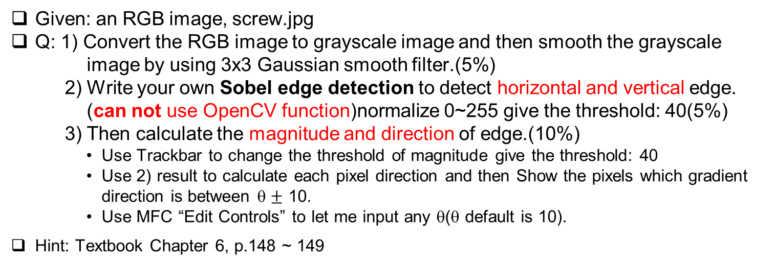
2. Edge Detection (20%) (出題：Ben, Carol)
Given: an RGB image, screw.jpg
Q: 1) Convert the RGB image to grayscale image and then smooth the grayscale image by using 3x3 Gaussian smooth filter.(5%)
2) Write your own Sobel edge detection to detect horizontal and vertical edge. (can not use OpenCV function)normalize 0~255 give the threshold: 40(5%)
3) Then calculate the magnitude and direction of edge.(10%)
Use Trackbar to change the threshold of magnitude give the threshold: 40
Use 2) result to calculate each pixel direction and then Show the pixels which gradient direction is between θ $±$ 10.
Use MFC “Edit Controls” to let me input any θ(θ default is 10).
Hint: Textbook Chapter 6, p.148 ~ 149
vertical edges
magnitude
direction
0
40
255
10
Horizontal edges
screw.jpg

Slide 12
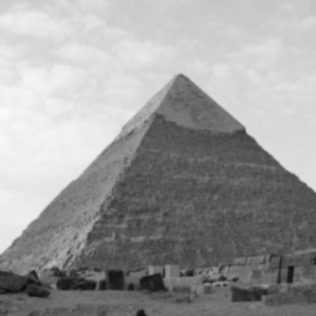
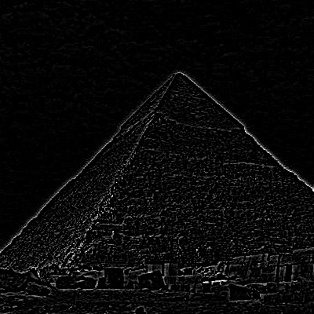
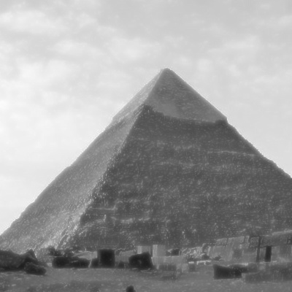


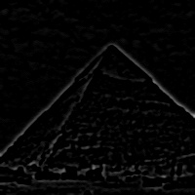



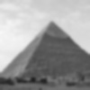

3. The Gaussian and Laplacian pyramids (20%) (出題：Erin, Daniel, Oscar)
Given: an image, pyramids_Gray.jpg
Q: show Gaussian and Laplacian pyramids, also show the inverse process images for recovering the original image from the subimages.
1) Show Gaussian(3x3) pyramid level 1 image (5%)
2) Show Laplacian pyramid level 0 image (5%)
3) Show Inverse Gaussian pyramid level 1 image (5%)
4) Show Inverse Gaussian pyramid level 0 image (5%)
Hint: OpenCV textbook chapter 5，p.130~132, GAUSSIAN_5x5 =
Gaussian pyramid
Laplacian pyramid
Inverse Gaussian pyramid
level 0
Gaussian Blur
level 1
level 2

Slide 13
4. (20%) Adaptive Threshold (出題: Edward, Jenny)
4.1 Global Threshold (10%) 4.2 Local Threshold (10%)

Slide 14
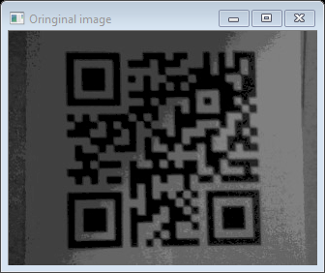
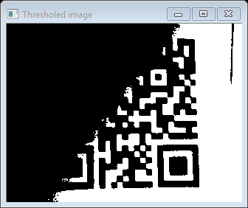
4.1 Global Threshold (10%)
Given: a non-uniformly illuminated QR.png
Q: 1) Show original image
2) Show the result after applying global threshold
Hint:
OpenCV Textbook Chapter 5 (p.136~138)
threshold(args) func with threshold value = 80
QR.png
global threshold

Slide 15
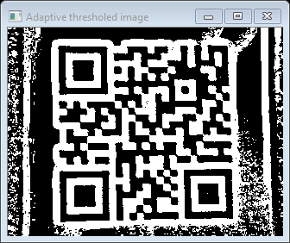
4.2 Local Threshold (10%)
Given: a non-uniformly illuminated QR.png
Q: 1) Show original image
2) Show the result after applying local threshold
Hint:
OpenCV Textbook Chapter 5 (p.136~138)
adaptiveThreshold(args) func with blockSize = 19, offset = -1
QR.png
local threshold

Slide 16
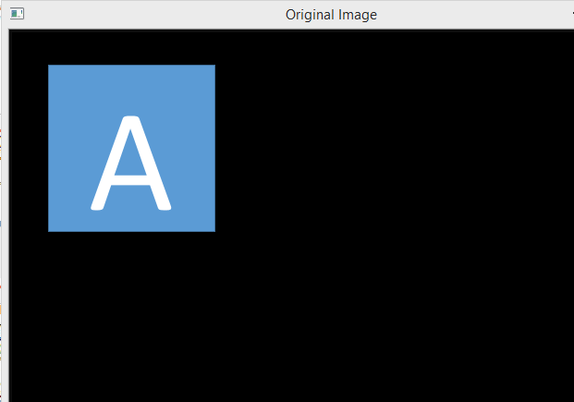
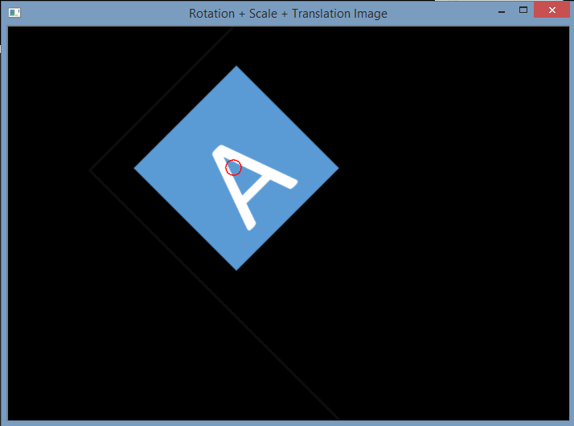
5.1 (10%) Transforms: Rotation, Scaling, Translation (出題：Tri, Helen, Ann)
Given: OriginalTransform.png image
Q: 1) Click button “5.1”, OriginalTransform.png should be showed.
2) Please rotate, scale and translate the small squared image (as Figure 3.1) with following parameters (should be entered in the GUI (using Edit Control)):
(1) Angle = 45⁰ (counter-clockwise)
(2) Scale = 0.8,
(3) Translation with:
x_{new} = x_{old} + 150 (Tx) pixels = 130 + 150 = 280
y_{new} = y_{old} + 50 (Ty) pixels = 125 + 50 = 175
Point C (130,125) is center of small square image
Hint: OpenCV Textbook Chapter 12 (p. 407 ~ p. 412, warpAffine(…);
EX:
Small square image
C (130,125)
C (280,175)
45⁰
Figure 3.1 Original Image
Figure 3.2 Rotation, Scale and Translation Image

Slide 17
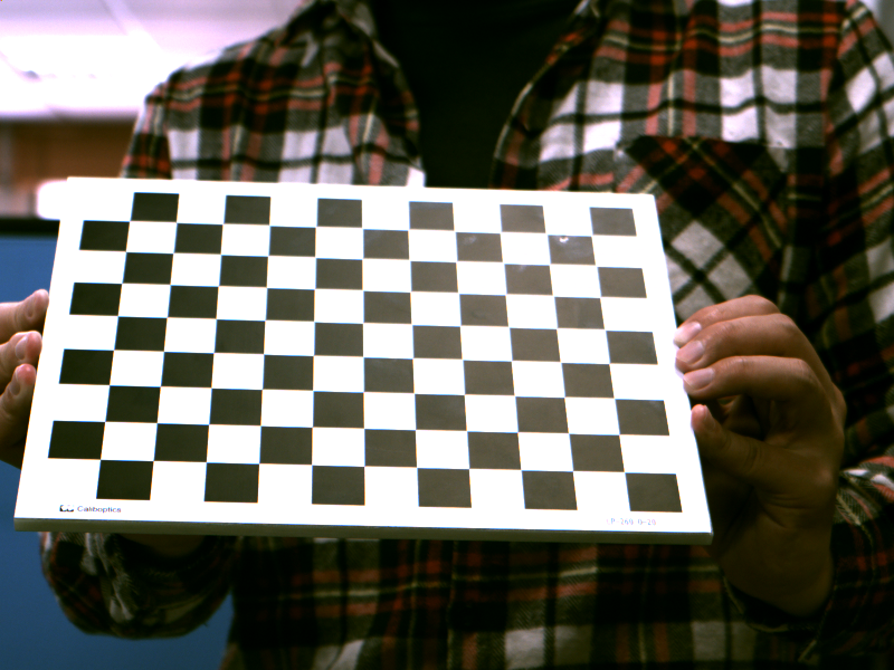
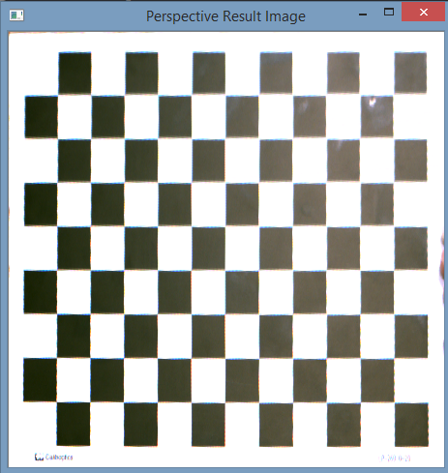
5.2 (10%) Perspective Transformation (出題：Tri, Helen, Ann)
Given: OriginalPerspective.png image
Q: Use OpenCV functions to straighten the image
1) Click button “5.2” to show image in the new window. Then do:
Click 4 points showed in console window. (start from top-left corner of the original image, and then click clock-wise)
Warp the original image to the location (20,20), (20,450), (450,450), (450,20). Open second window to show the result.
Hint:
Textbook Chapter 6
mouse callback function(p.96)
(20,20)
(450,20)
(20,20)
y
1
2
x
4
3
Original Perspective
(20,450)
Perspective Image
(450,450)

